Slide 1




Summer Internship – Review
AI BASED PAPER EVALUATION
Presented by:
22A91A6167 - A V V S S Prasad - AIML
Faculty Mentors:
G Siva Shankar - AIML

Slide 2
PROBLEM STATEMENT
The traditional manual grading system for descriptive exam papers is increasingly inadequate
in addressing the demands of modern education.
This conventional approach is time-consuming, prone to human errors, and lacks scalability, making it challenging to manage large volumes of student assessments efficiently.
Additionally, manual grading can introduce inconsistencies and biases, leading to unfair evaluations and delayed feedback for students.
As educational institutions expand and the number of assessments grows, there is a pressing need for an automated solution that ensures timely, consistent, and objective grading.
•
An AI-based exam paper
the grading process, ther assessments.
evaluation system aims to address these challenges
eby enhancing efficiency, fairness, and scalability
by automating
in educational

Slide 3
Objective
Automate exam paper evaluation to enhance efficiency, consistency, and fairness.
It aims to reduce manual grading burden, provide timely feedback, and scale assessments for large student populations, freeing educators for focused teaching.
Covers automated grading of semi-automated evaluation of subjective ones (short answers, essays) by assessing content, coherence, and grammar.
It includes Text recognition, plagiarism detection, and performance analytics.
While strong on content, it still has limitations in assessing deep creativity or highly nuanced interpretations.

Slide 4
Methodology
Students upload typed PDF answer scripts through the web application.
OCR is applied to extract text from the PDFs for further processing.
The extracted text is cleaned and organized into question-wise responses.
Faculty-provided model answers are used to evaluate student responses using the LLaMA3 model.
The system generates scores and feedback, which are stored in MongoDB and displayed in the frontend.
tion (OCR) ng (NLP)
rontend ) Storage)
Technologies Used
• Optical Character Recogni
• Natural Language Processi
• LLAMA3
• MERN
• HTML , CSS ,JavaScript(F
• MongoDB(For Data Base

Slide 5
Current System Features
Existing users log in, while new users are directed to a signup page.
Successful new user registration redirects to login, then to the Exam Setup Page.
The Exam Setup Page stores exam details in the database before proceeding to the Upload Script page.
The Upload Script page enables PDF exam script uploads via selection or drag-and-drop.
OCR extracts text from uploaded PDFs, which is
techniques.
The LLaMA3 model evaluates descriptive answers b answers.
The system automatically generates marks and detailed f
All exam data, student answers, results, and feedback are future access.
then processed using NLP
y comparing them with model
eedback for student answer.
securely stored in MongoDB for

Slide 6
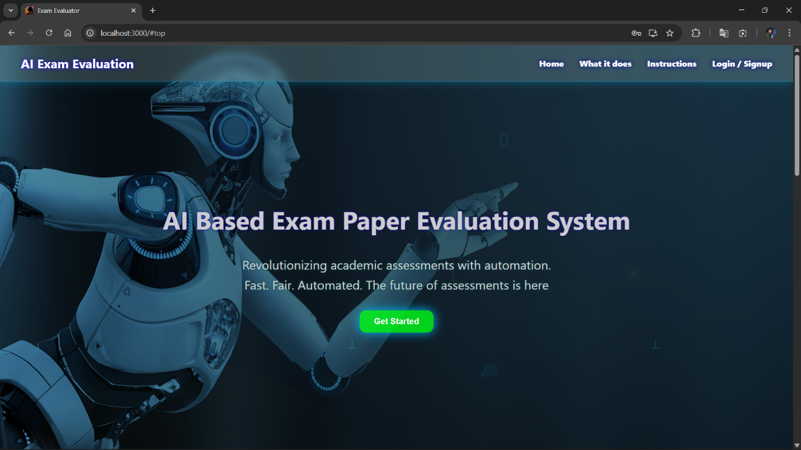
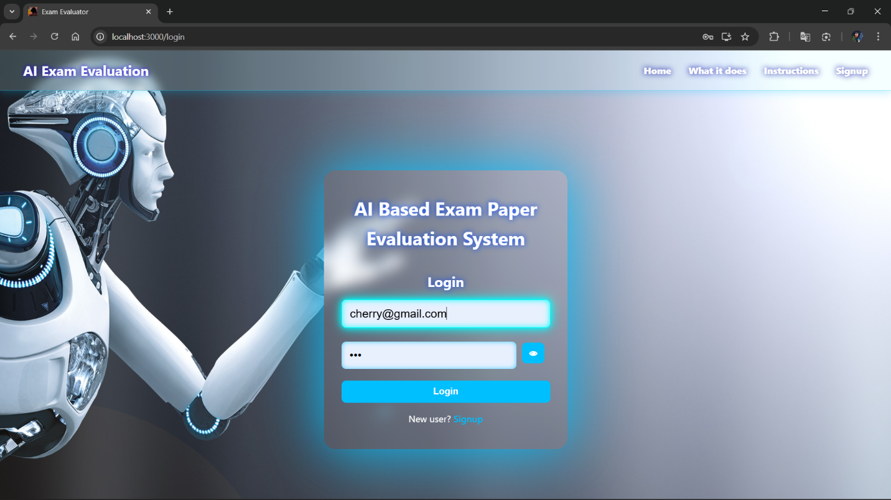
Implementation Screen Shots

Slide 7

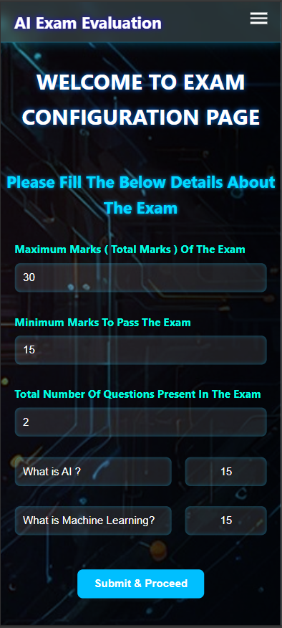
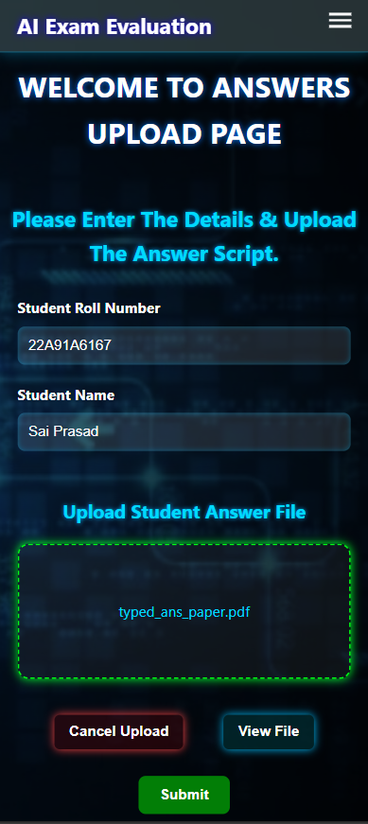
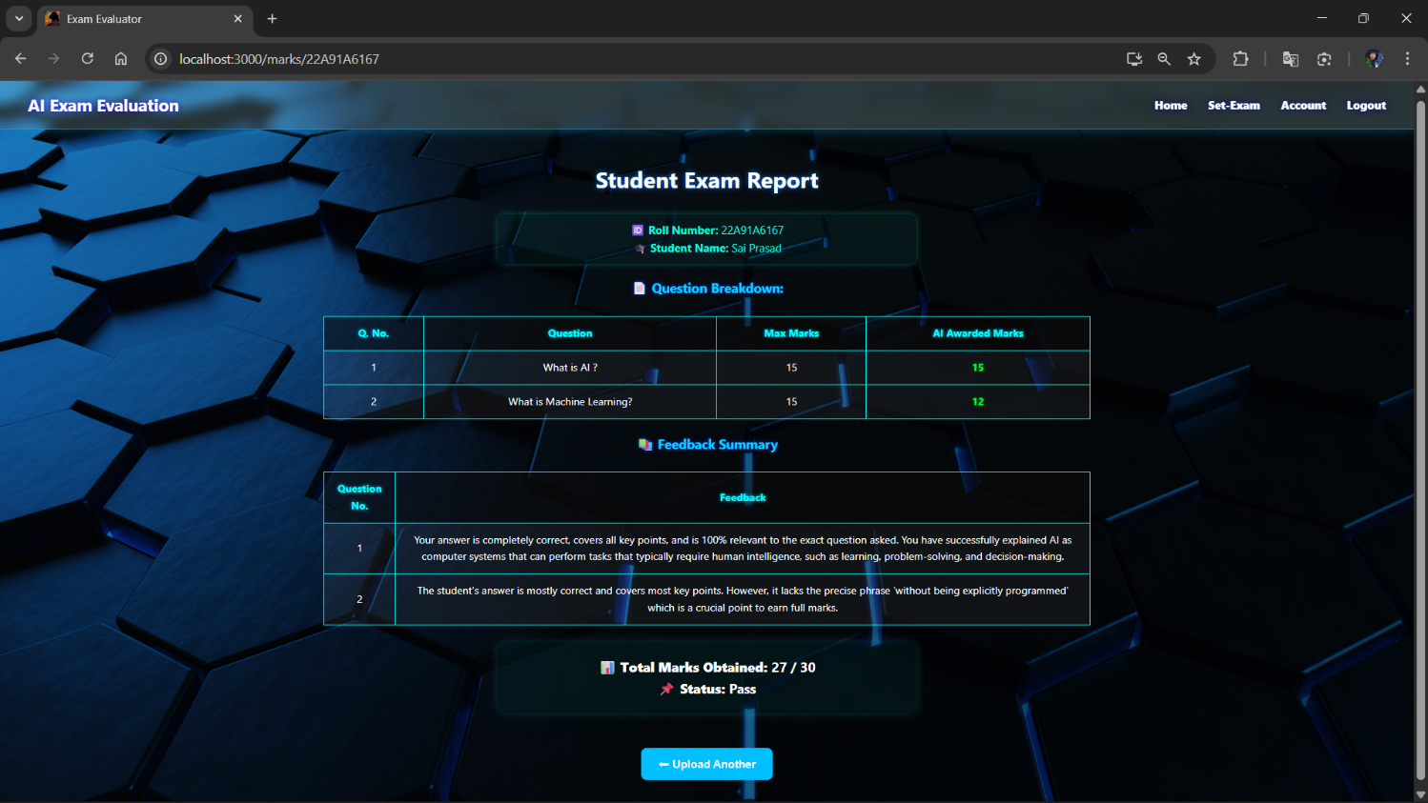
Responsive Design
Mobile View
Desktop View
AI Based PAPER EVALUATION

Slide 8
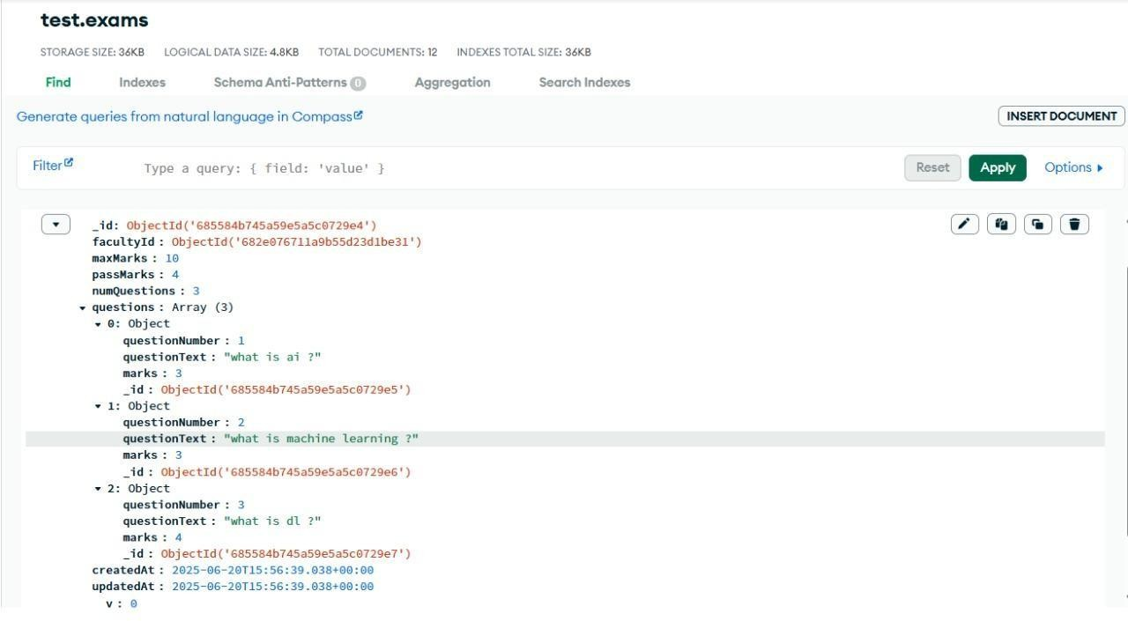
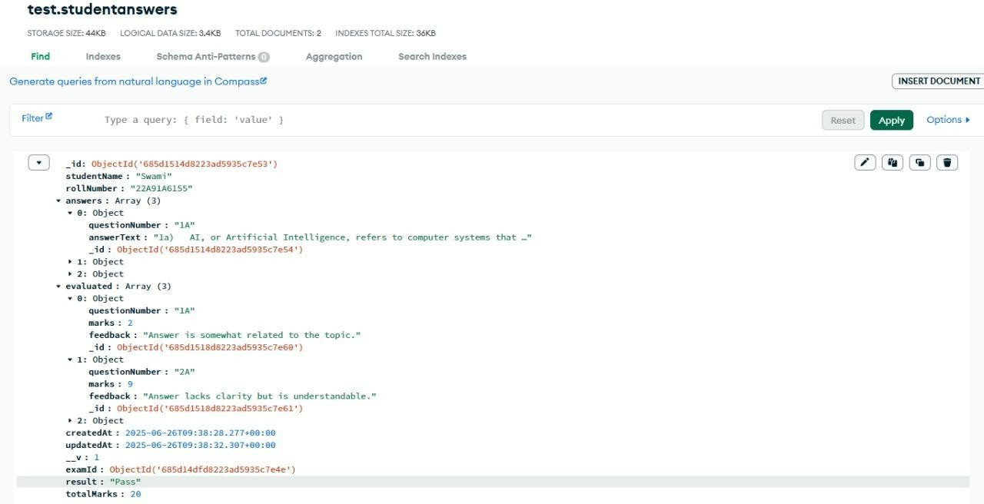

Slide 9
Conclusion
Developed a full-stack web application to automate digital exam paper evaluation using
AI.
Successfully extracted digital text from uploaded PDF answer scripts.
Integrated LLaMA3 LLM model to evaluate student answers against AI-generated model
answers.
Ensured secure user access, role-based exam setup, and centralized data handling.
Created a clean, user-friendly interface for seamless workflow and usability.

Slide 10
THANK YOU

